Slide 1
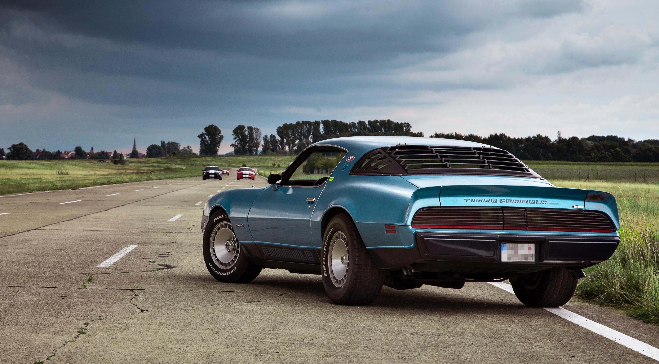
TECHNOLOC
presentation
Welcome Car Rental Company!
YOUR TEAM
Jamie Thurecht | Andrew| Jason | Leo | Dora | Di Li

Slide 2
Your needs
Car Orders
Check Customer Information
Retrieve Car Information
Analyse Store data
Data Presentation
Car Recommendations
Holistic Management System

Slide 3

SHOWCASE

Slide 4
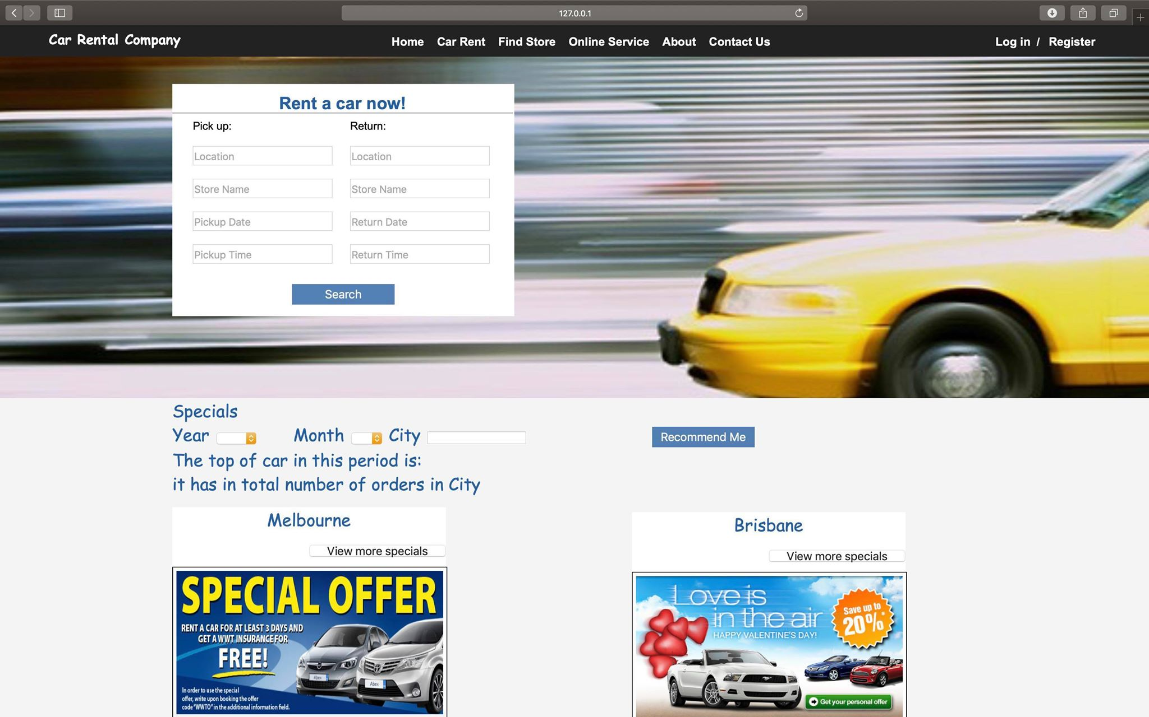

Slide 5
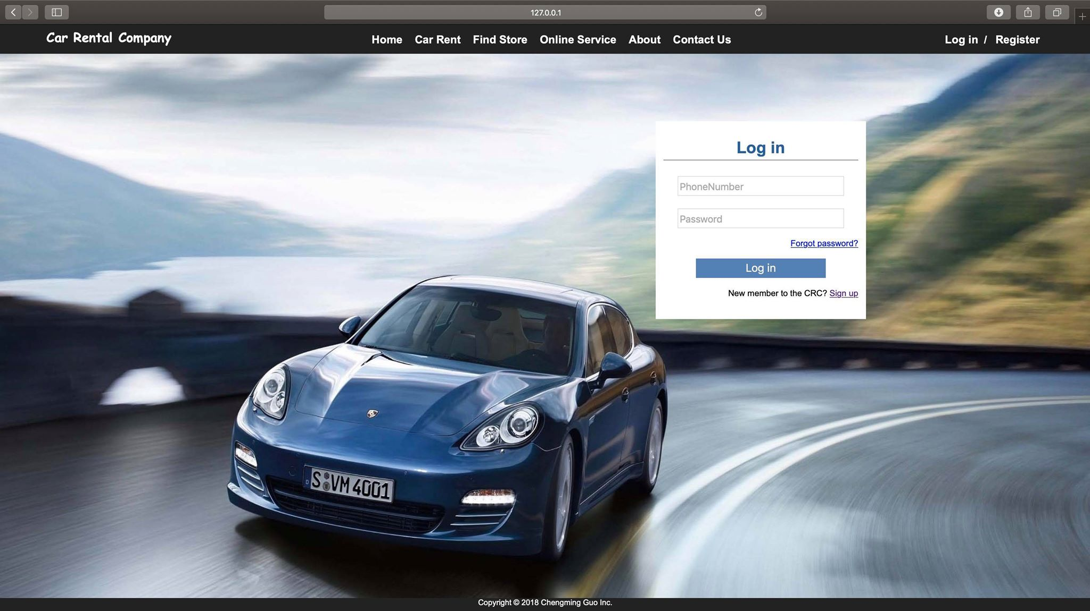

Slide 6
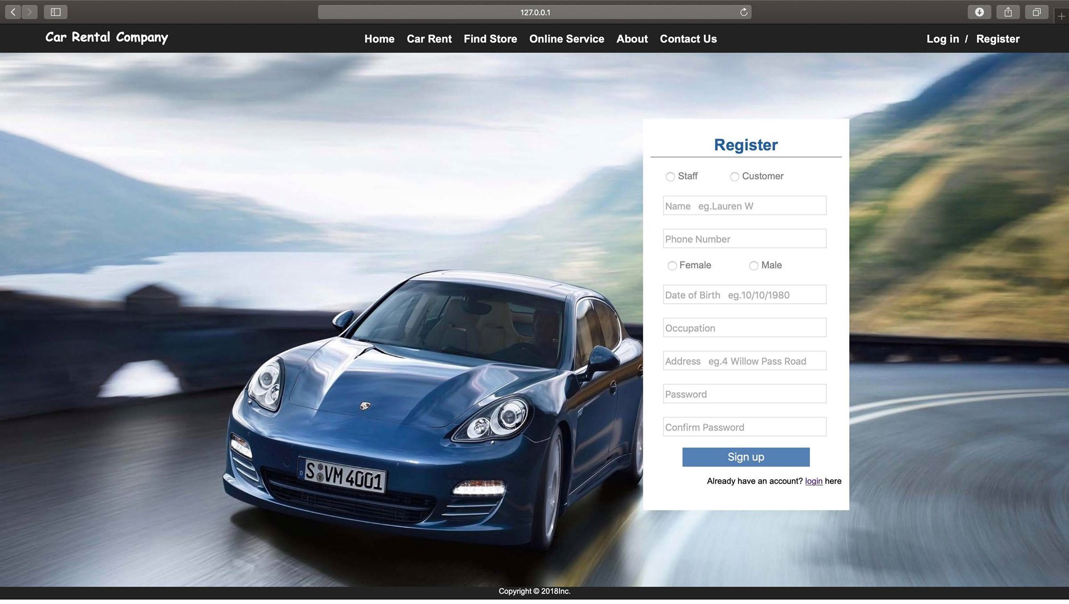

Slide 8
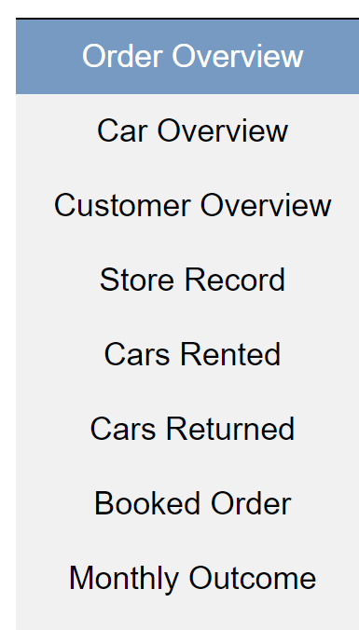
Data Extraction
Sort your data however you want
Your business your way

Slide 9
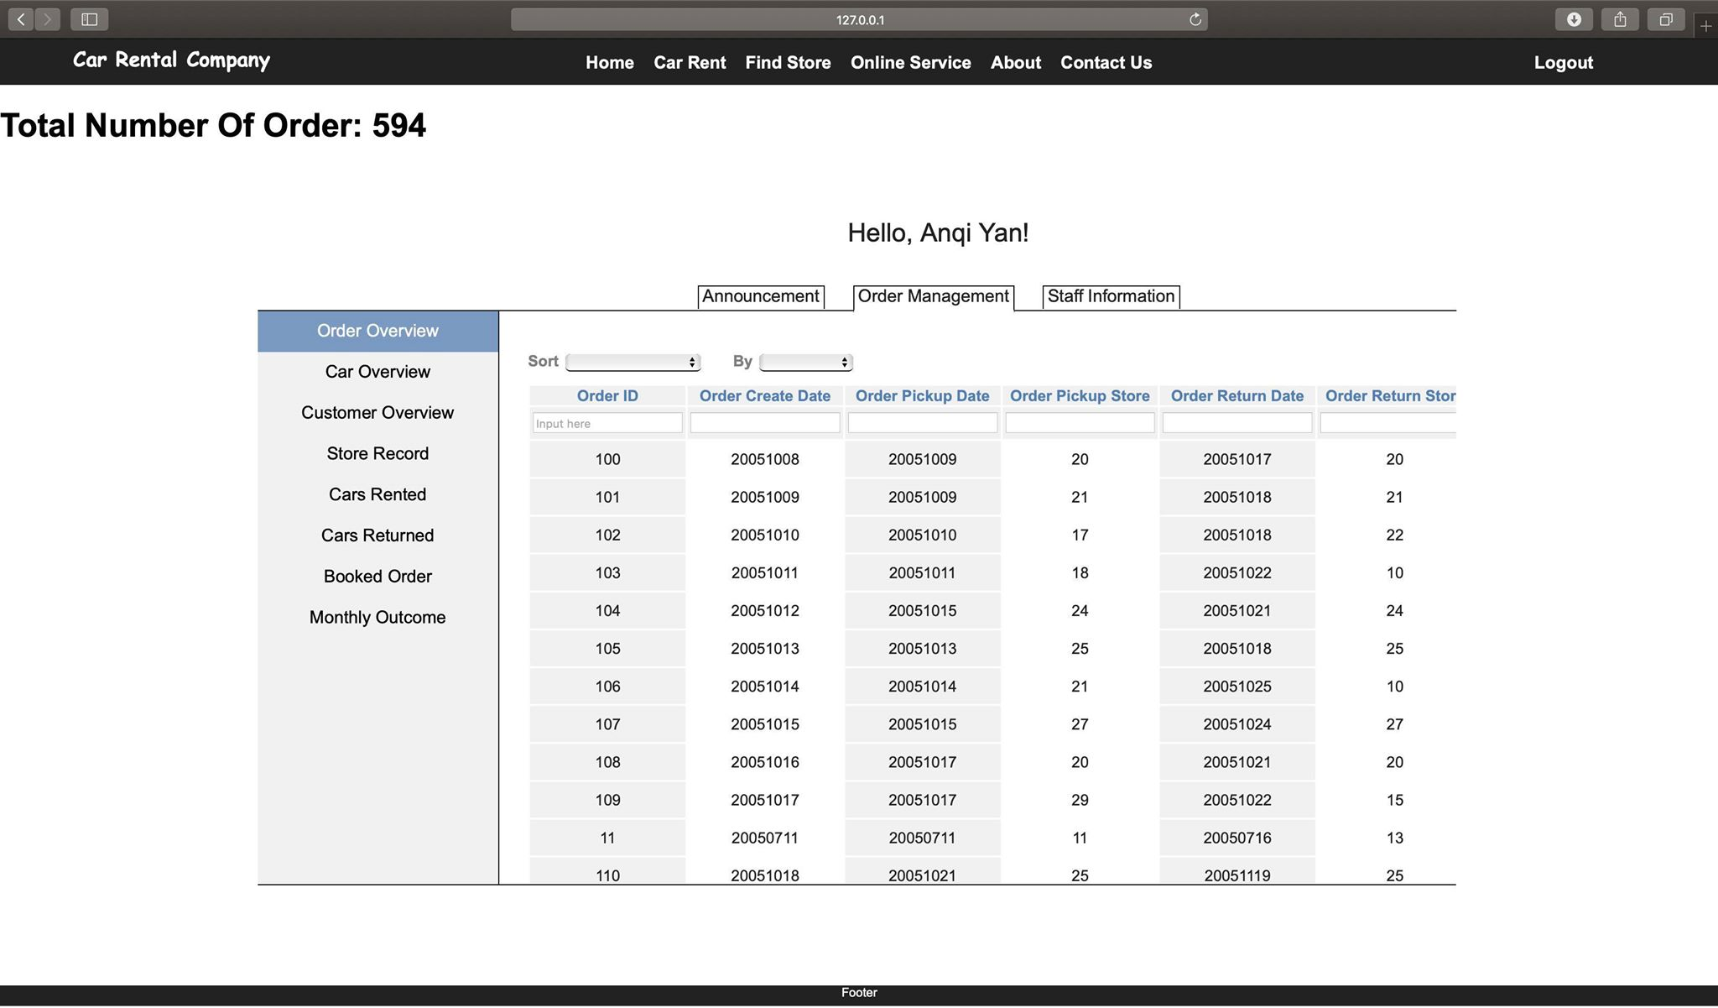
Manage Your Orders

Slide 10
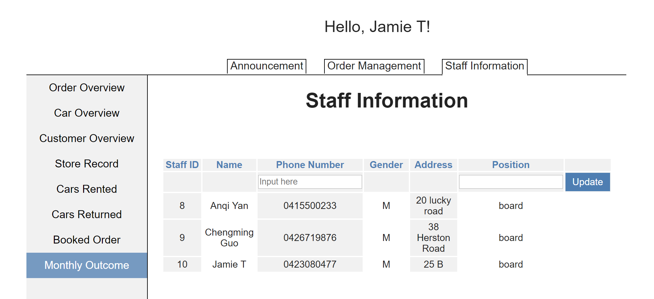
Manage Your Employees

Slide 11
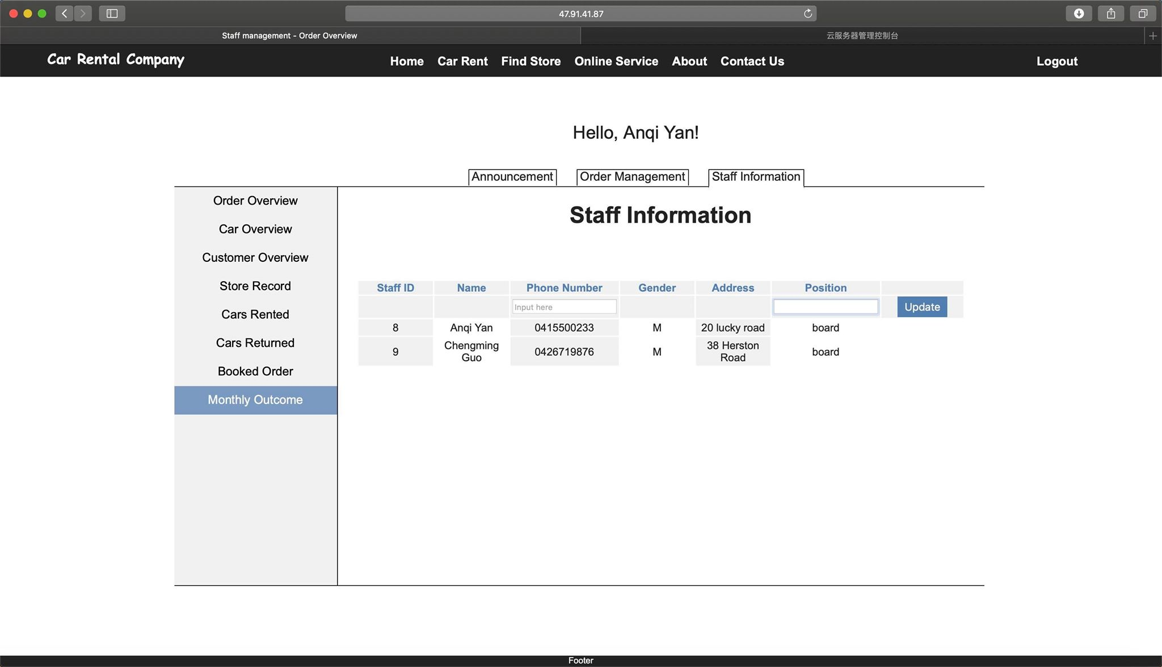
Role Authority
Manage your employees and what they can access by position

Slide 12
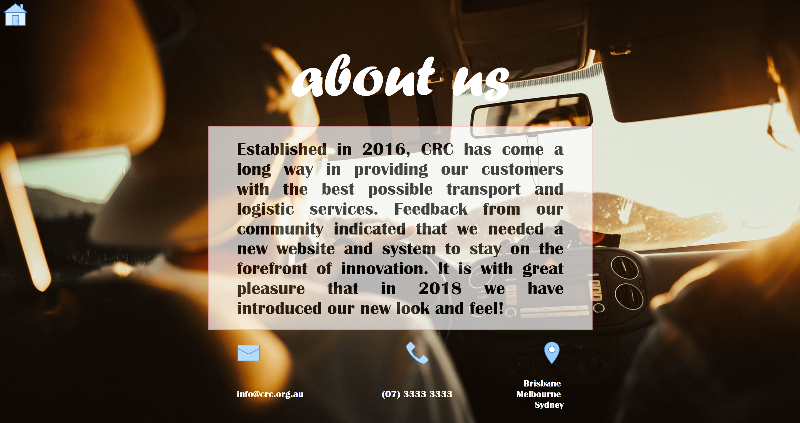
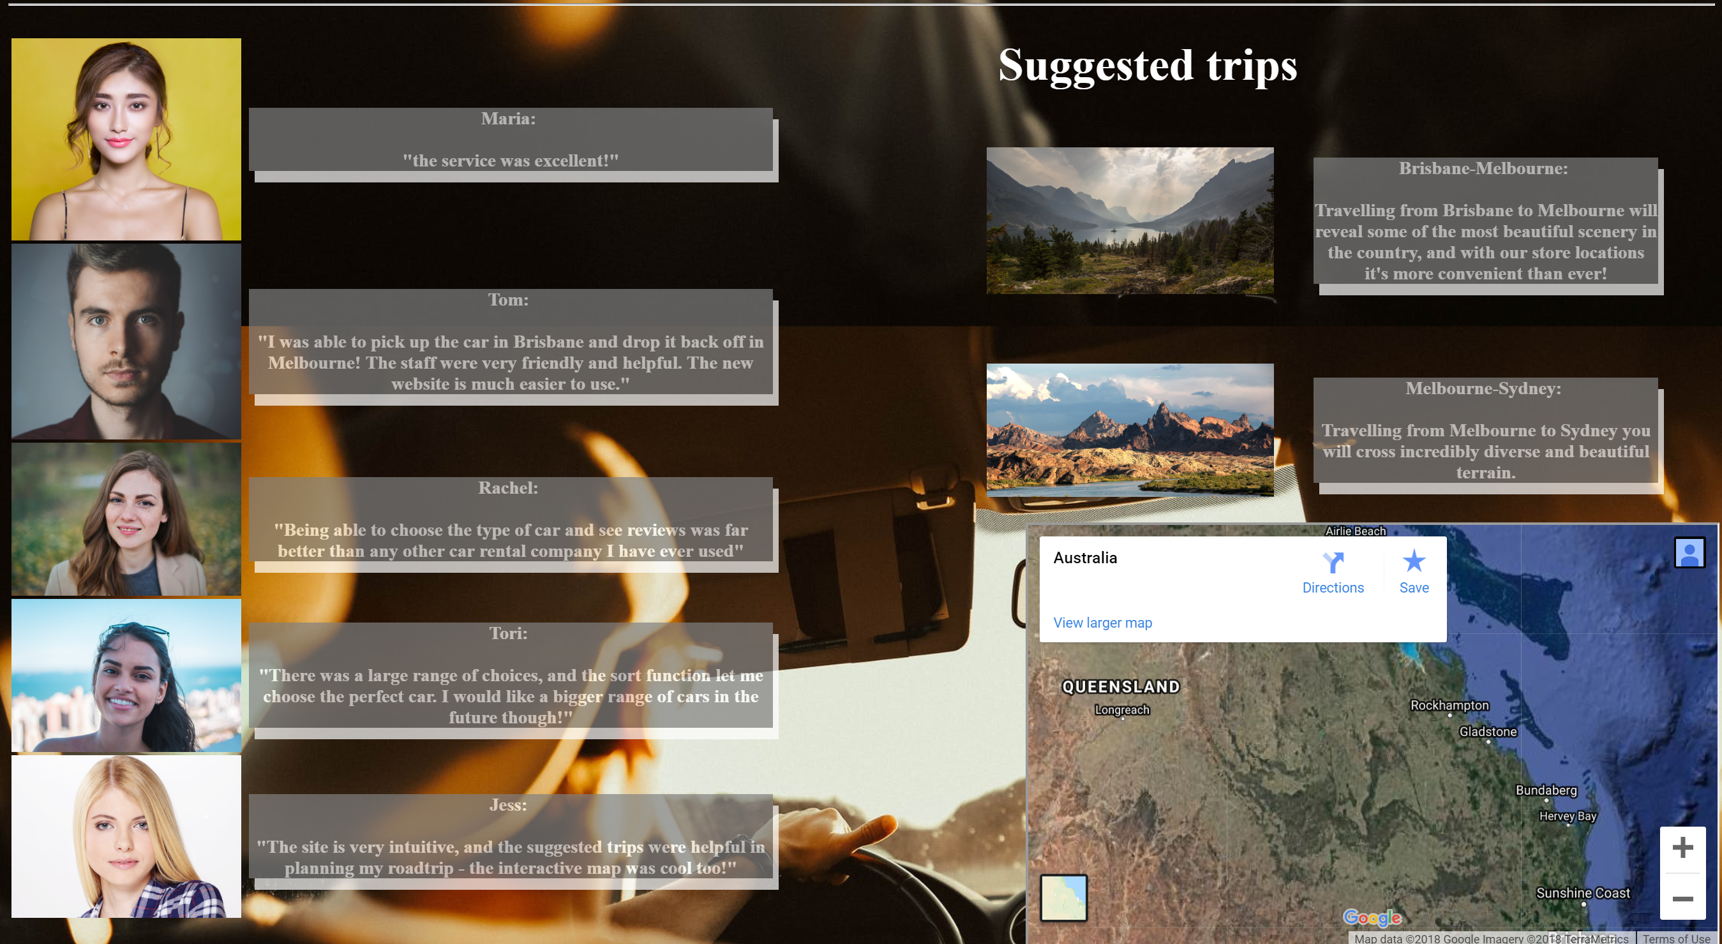

Slide 13


Quality Assurance
Stringent testing has been applied to all currently functional parts of the system
Any bugs were ironed out
System is ‘ready to roll out’ with current basic functionalities

Slide 14

FUTURE

Slide 15
Increasing scope
All future implementations are additional functionalities only
Future projects are more than just basic functionality
Not added to scope during sprints to remove the potential for ‘scope creep’

Slide 16


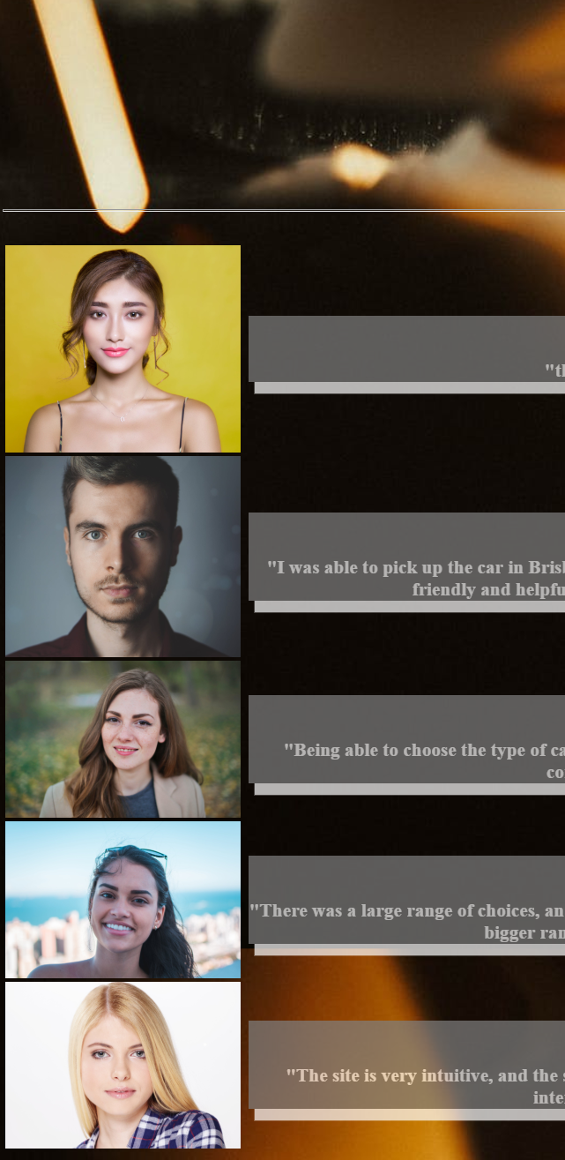
MOBILE OPTIMISATION

Slide 17
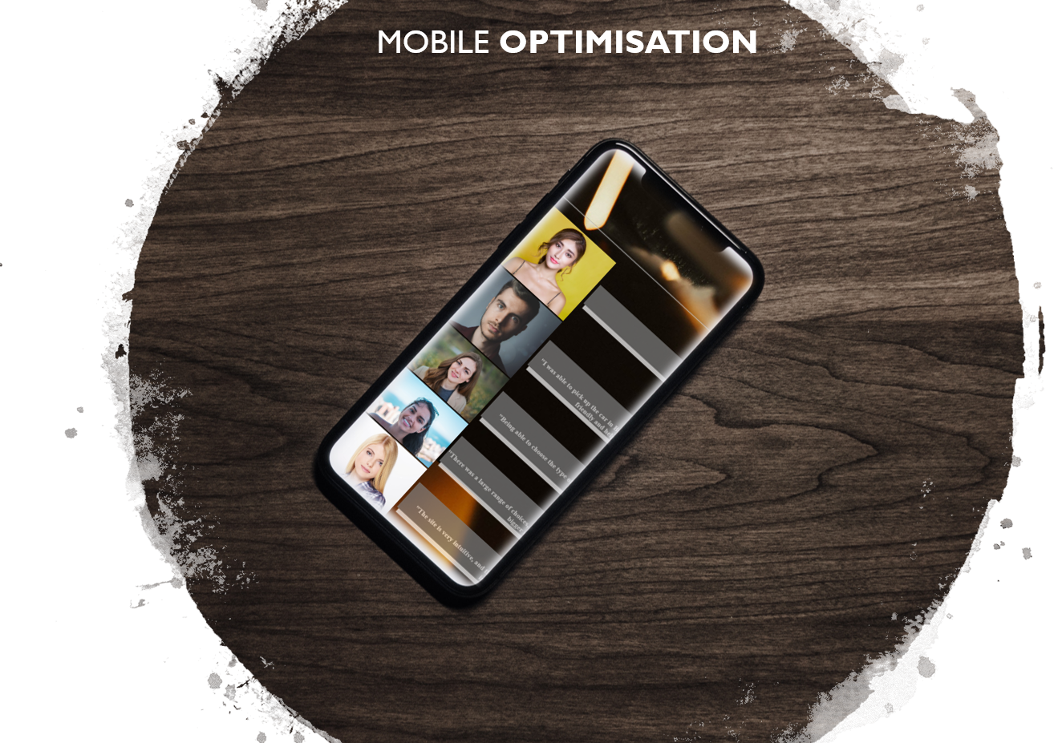
On-the-go bookings
Reflects your business as a fast-paced organisation
Quick access and changes available for clients
Improved user experience
Increased average time on site
Competitive advantage over competition

Slide 18

Build customer relations
Create loyalty programs inbuilt into your system
Increase customer base
Build public perception
Avoid risky transactions through customer record analytics

Slide 19

Integrated Booking Notifications
Integrate bookings with automatic notifications
Have staff notified of bookings to have orders prepared for customers
Have customers notified of booking status and updates automatically and seamlessly
Send reminders to customers of when to return their cars - and to where

Slide 20

Implement our IntelliSys© system for complex data analysis
Custom software integration
Artificial intelligence with smartouch functionality allows for past and current analysis
Future predictions generated based on current trends and external inputs/preferences

Slide 21
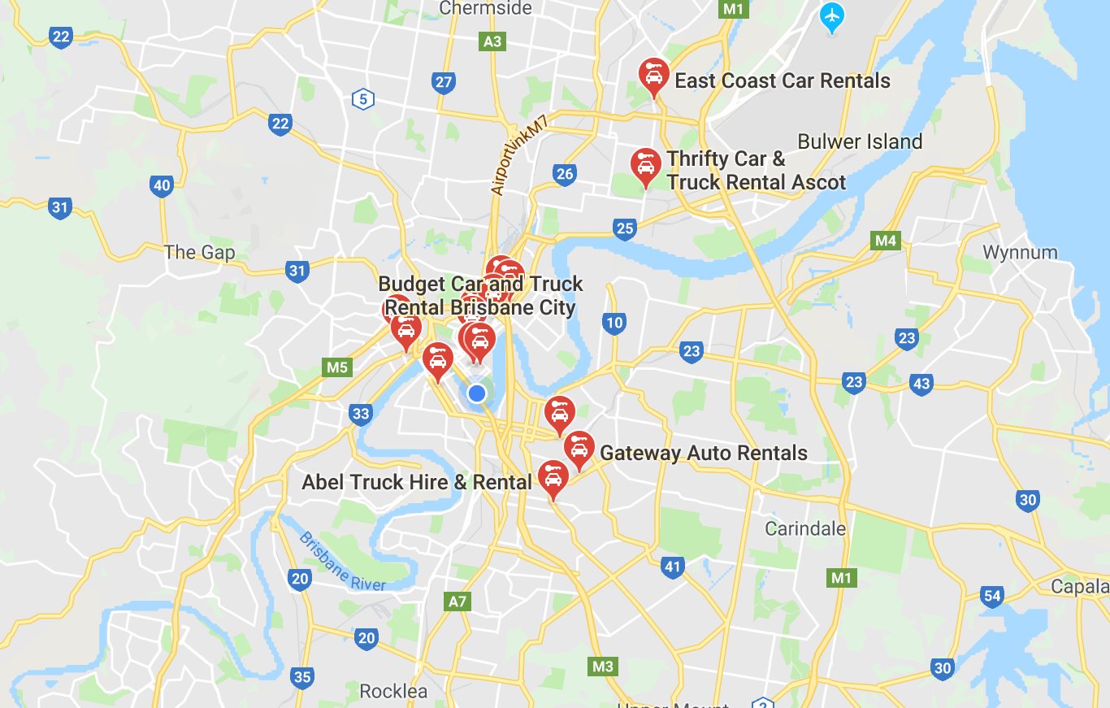
Store Locator
Utilising customer location, directions to the closest stores are provided
Particularly useful in tandem with mobile optimisation for convenience
Maps and directions are provided for trips, starting and ending at different store locations
Google Maps technology

Slide 22
SmartShout Announcements
Implement our SmartShout© system and reach your employees wherever they are
Shout your announcement to employees, sorted by position and/or store

Slide 23
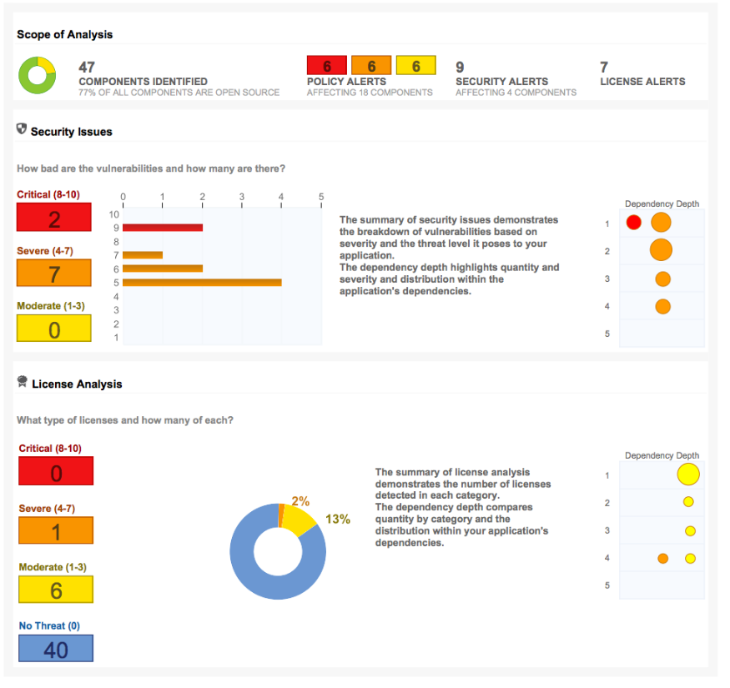
Report Downloading
Select fields to download
Automatically generate your report
Download reports as PDFs
Any mix of field selection is available as checkboxes
Car type/store/monthly/yearly/car brand/etc.
Example only

